Slide 1
Cpt
OPT
&
h-1b
https://international.colostate.edu/isss/resources/employment/student-employment-resources/
Notes:
Curricular Practical Training- must be done before degree program completion
Optional Practical Training- may be done before or after degree program completion, but after degree program completion is encouraged.

Slide 2
CPT:
CURRICULAR PRACTICAL TRAINING
https://international.colostate.edu/isss/resources/employment/student-employment-resources/

Slide 3
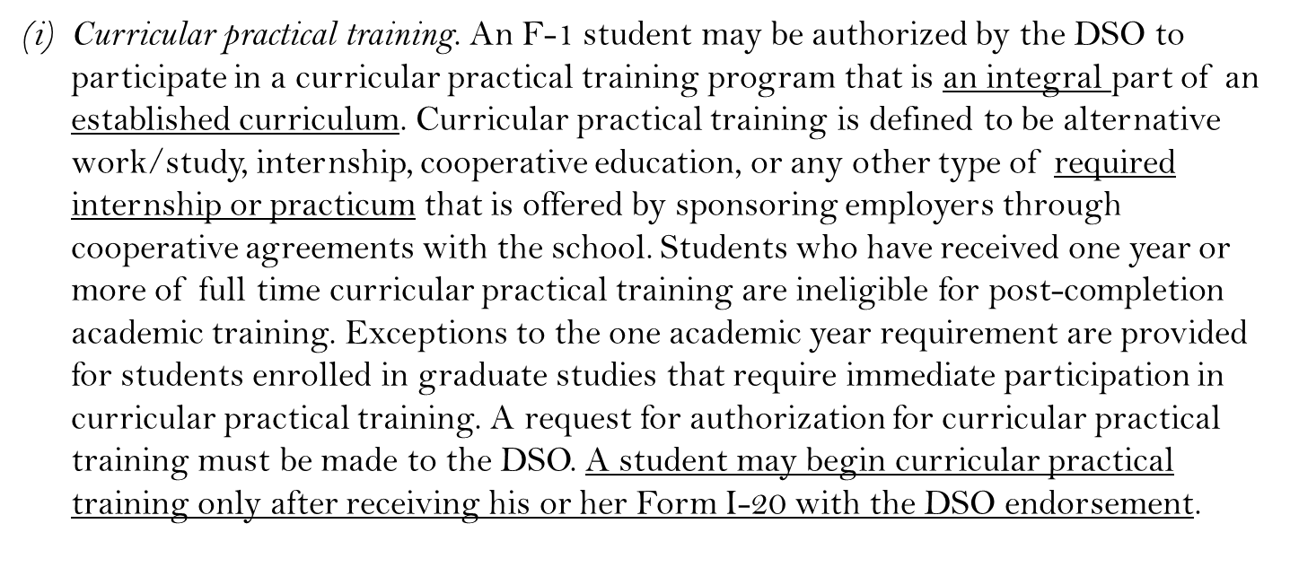
Curricular Practical Training (CPT):
Regulation 8 C.F.R. § 214.2(f)(10)(i)

Slide 4
What is CPT?
CPT is required or optional employment that is an INTEGRAL part of an established curriculum as listed in the immigration regulations. It must have a strong and measureable connection to the student’s academic program.
Must be approved by ISSS after they review your request to determine if it is part of the curriculum or just employment in your field.
Employment which is just in your field of study does not qualify for CPT! It must be an established part of your academic curriculum.
CPT can only be done before completion of your degree program.
Graduate students who miss the graduate school’s graduation deadline are considered to have completed their program and are no longer eligible for CPT the following semester (even though you are required by the graduate school to register for Continuous Registration).

Slide 5
General Criteria for F-1 CPT
Maintaining F-1 status.
Enrolled full-time at a service-approved college, university, or seminary for at least 1 academic year prior to beginning CPT.
Graduate students may qualify earlier for CPT only if required by their academic program.
CPT that is not listed as a degree completion requirement will be limited by ISSS to 3 terms (including summer) of CPT authorization per degree level. Your academic department may have stricter limitations. The exception to this is students working on thesis/dissertation research.

Slide 6
Part-Time vs. Full-Time CPT
Part-Time CPT (20 hours per week or less)
Will not affect eligibility for OPT.
Full-Time CPT (More than 20 hours per week)
Students who use 12 months or more of full-time CPT will lose eligibility for OPT.

Slide 7
CPT Application Packet
Completed Request for CPT Authorization application form (available on ISSS website)
Completed & signed Academic Advisor Form
Completed Employer Form
Completed application should be turned in to ISSS a minimum of 2 weeks prior to desired employment start date

Slide 8
Request for CPT Authorization Form
Choose your start and end dates.
Authorization can only be granted for one semester at a time, except programs overlapping with winter and summer break. Note: If you are participating in a residency program that requires CPT, approval is only needed once a year.
Select full-time or part-time CPT.
Sign to verify that you have read and understand all the instructions on page 2 of the CPT application packet.

Slide 9
CPT Academic Advisor Form
Academic advisor must outline the learning objectives of the employment and explain how the opportunity is an ‘integral part of the student’s established curriculum’.
Will need to know who will be evaluating the CPT to determine if learning objectives were met.
Signature is required by the student’s Academic Advisor.

Slide 10
CPT Academic Advisor Form
Four Possible Reasons for CPT:
The employment is required for the student’s degree. Must be documented as such in an official university publication. Example: Construction Management requirements.
The student will earn internship or independent study credit. Students must be registered for the appropriate credit before the CPT can be authorized.
The employment will provide research that facilitates the successful completion of student’s thesis or dissertation. Student must be registered for CR or thesis/dissertation credit during the Fall and Spring terms.
The employment will yield a project for a particular course that is required by the student’s degree program. This could include a paid internship that is one of several options required for a specific course

Slide 11
CPT Employer Form
Job title and duties
Number of hours per week
Start and end dates of employment
Physical address of employment
Supervisor contact information and signature

Slide 12
Additional Considerations
You may not begin CPT until you have a new I-20 authorizing the CPT employment.
You may not work before the start date or past the end date listed for your CPT authorization.
Employment for the primary purpose of gaining work experience and financial compensation does not qualify for CPT.
Students must maintain full-time academic enrollment or have an authorized reduced credit load for the semester during which CPT will take place.
If required coursework has been completed, students are only required to register for an internship course, thesis/dissertation credit, or Continuous Registration (CR).

Slide 13
OPT:
OPTIONAL PRACTICAL TRAINING
https://international.colostate.edu/isss/resources/employment/student-employment-resources/

Slide 14
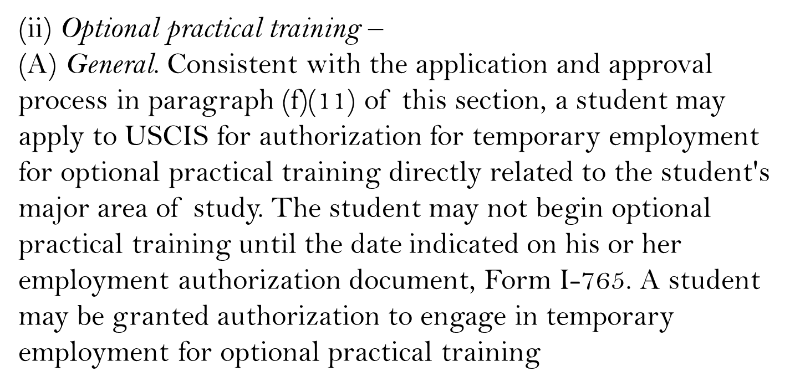
OPTIONAL PRACTICAL TRAINING:

Slide 15
WHAT IS OPT?
OPT is temporary employment for practical training in your field of study (the major/program
listed on your I-20)
OPT is a benefit of your F-1 status. It is not a separate status.
OPT is available at each progressing degree level.
OPT can be approved for up to 12 months of employment authorization.
OPT requires approval from USCIS (United States Citizenship and Immigration Services).
Can be done either before (pre-completion) or after (post-completion) your degree program.

Slide 16
PRE COMPLETION OPT:
Used for employment before your academic program is completed.
Unemployment is not counted.
Limited to 20 hours per week during fall and spring semesters.
Does not qualify for STEM extension.
May extend I-20 if extra time is needed.
Pre-Completion OPT time is subtracted from Post-Completion eligibility.

Slide 17
POST COMPLETION OPT:
Used for employment after academic program is completed.
Unemployment counts (limited to 90 days).
Must work full-time (20 hours per week or more).
May be able to apply for STEM extension.
May be eligible for H-1B cap gap extension.
Cannot extend I-20 if degree is not completed.
Graduate students may be able to apply during thesis/dissertation period.
The rest of this presentation will focus on post-completion OPT, as post-completion is far more common. See an international student advisor with questions about pre-completion OPT.

Slide 18
TIMING OF OPT APPLICATION
To apply for OPT you must determine your program end date and choose the OPT start date.
When will you complete all your academic degree requirements? This date should be your program end date.
Your OPT start date must be within 60 days of the program end date.
Graduate Students: degree completion is often sooner than graduation. Be mindful!
You can apply for OPT up to 90 days before and up to 60 days after your program completion date.

Slide 19
opt timeline:
EACH BOX REPRESENTS 1 MONTH
90 days
before program end date:
Earliest date to
apply for OPT
Program end
date
60 days
after program end date:
Application
must be
received by
USCIS
14 months
after program
end date:
OPT must be
completed,
regardless of
when it started

Slide 20
HOW TO APPLY FOR OPT
Applying for OPT is a Two-Step Process:
Step One: Complete the ISSS "Post-Completion OPT I-20 Request E-form" to get your new I-20 with the OPT recommendation.
Step Two: Apply for OPT by submitting the I-765 via the USCIS website.

Slide 21
HOW TO APPLY: STEP 1
Complete the "Post-Completion OPT I-20 Request eForm” on the ISSS website.
You do not need a job offer to apply for OPT.
Keep in mind it can take ISSS up to 10 days to process your OPT I-20 request.
We recommend applying early, especially if you want to work shortly after graduation.

Slide 22
HOW TO APPLY: STEP 2
Begin the OPT application (I-765) on the USCIS.gov portal. You will need:
I-20 with OPT Recommendation from ISSS (step 1)
Printed, signed & dated, and scanned I-20
Passport and I-94 photocopies ready to upload
Two new passport sized photos (taken within the past 30 days)
$410 available by debit or credit card for electronic payment
Copies of any previously issued EAD cards

Slide 23
HOW TO APPLY: STEP 2
The "Mailing Address" you provide is where your EAD card will be shipped. The U.S. Post Office will not forward government mail.
If you don’t know where you will be living in 2 - 5 months, you can use the ISSS office address, and we can forward it to you.
Please see the instructions in the email with the OPT Recommendation I-20 for more information on how to file the I-765 online.
Pay attention to the dates:
Your OPT application must be received by USCIS no later than 30 days after your new I-20 was created. ISSS can re-issue the OPT I-20 if necessary. Also, your OPT application must be received by USCIS no later than 60 days after your program end date.

Slide 24
AFTER YOU APPLY
After submitting your application, you will receive your receipt number.
You can check the status of your application from your USCIS online account
It is not useful to call USCIS National Customer Service to inquire about your application or to request expedited processing.
Contact an international student advisor if your application has been pending for longer than 120 days.

Slide 25
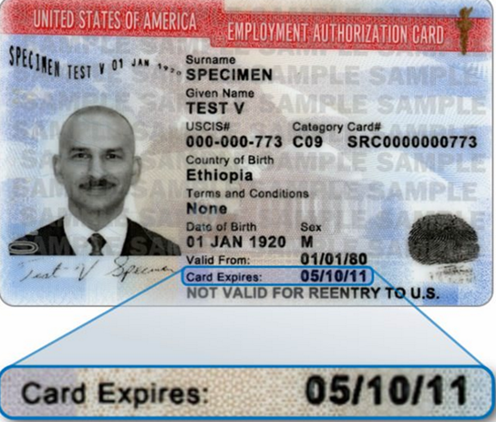
AFTER RECEIVING YOUR EAD CARD
Send ISSS a copy.
Do not start work before receiving your EAD or before the start date on the EAD.
Do not work after the expiration date.

Slide 26
MAINTAIN STATUS DURING OPT
You must have a job or training opportunity that is directly related to your degree.
It is up to you to determine if the training is related to your degree.
The ISSS Office does not determine whether your training is related.
You need to feel comfortable justifying the work you are doing if you are ever questioned by an immigration official.
If you change your status prior to the end date on your OPT, please send ISSS copies of your new immigration documents.
After you complete your OPT, submit a departure eForm (available on the ISSS website).

Slide 27
TYPES OF EMPLOYMENT PERMITTED
Regular paid employment (can be one employer or multiple employers)
Payment by multiple short-term employers
Work for hire
Self-employed business owner (consult with an attorney if you want to pursue this option)
Employment through an agency
Unpaid internships
Volunteer work (remember this option!)

Slide 28
EMPLOYMENT REQUIREMENTS
During OPT, your F-1 status is contingent upon employment.
You are permitted up to 90 days of unemployment during OPT. During periods of unemployment, weekends and holidays are counted toward this 90 days.
During periods of employment, weekends and holidays are not counted toward the 90 days.
To stop the unemployment “clock,” you must submit an OPT reporting eForm to ISSS at the beginning of your employment and every 3 months.
Every day without a job reported to SEVIS counts as unemployment. Working less than 20 hours per week also counts toward unemployment.
On the 91st day of unemployment, you would be out of status and need to depart the U.S.

Slide 29
REPORTING REQUIREMENTS
OPT is a benefit of F1 status, so the ISSS office will continue to maintain your SEVIS record throughout your OPT period.
You must submit an OPT reporting eForm to ISSS within 10 days of any changes to the following information:
Employer (start OR stop working)
Mailing address or email address
Change of legal name
Every day without a job reported to ISSS or SEVIS counts as unemployment! Your SEVIS record could be auto-terminated if you reach 90 days without reporting employment.

Slide 30
MAINTAINING RECORDS
Secure a letter from each employer with the following information:
Company name and address
Job title
Supervisor contact information
Description of the work and how it is related to your field of study
Dates of employment and the number of hours per week
This is especially important for volunteer work!

Slide 31
INTERNATIONAL TRAVEL
Travel outside of the U.S. while your OPT application is pending is not advised. There is increased risk involved.
Travel once your OPT has been approved is acceptable but you must:
Carry your EAD card
Have a valid F-1 visa (multiple entry and unexpired)
Have a valid passport (valid at least 6 months into the future)
Get an updated I-20 with a recent travel signature (less than 6 months old)
Carry a letter of employment (recommended)

Slide 32
GRACE PERIOD AFTER OPT
If you maintain your F-1 status throughout your OPT period, complete your OPT, and do not exceed your unemployment time, you are entitled to a 60-day grace period starting the date your OPT ends.
During the grace period working is not permitted, but you may remain in the USA, request a new I-20 to begin a new academic program (within 5 months), transfer to a new school, apply for a change of status, or travel in the U.S. before your departure.
If you decide to stop OPT or accumulate more than 90 days of unemployment, you are not eligible for a grace period.

Slide 33
OPT
STEM
EXTENSION
https://international.colostate.edu/isss/resources/employment/student-employment-resources/

Slide 34
WHAT IS THE STEM OPT EXTENSION?
F-1 students who completed a program of study in an eligible STEM (Science, Technology, Engineering, and Math) field may apply for a 24-month extension of post-completion OPT.
The list of eligible majors can be found here: https://www.ice.gov/doclib/sevis/pdf/stemList2022.pdf .
The 24-month extension requires a separate application and fee to USCIS.
During the 24-month extension period, students and their employers must fulfill additional reporting obligations that were not required during the initial 12-month period of OPT.

Slide 35
STEM OPT EXTENSION ELIGIBILITY
You are currently participating in approved post-completion OPT and have maintained your F-1 immigration status throughout your post-completion OPT period
You have earned a degree in a program of study that is included on the STEM list
You have not already been approved for 2 previous STEM OPT extensions.
You have a paid employer that is enrolled in E-Verify.

Slide 36
STEM OPT EXTENSION EMPLOYER
Your STEM OPT employer must be enrolled and in good standing with USCIS's E-Verify employment eligibility verification program
Your STEM OPT employer must provide you with formal training and learning objectives
Your employer must work with you to complete and certify Section 3 of the Form I-983 before you apply for the STEM OPT extension AND again during your STEM extension if there are any material changes to your training/learning plan
Your employer must review and sign your 12-month self-evaluation and your final evaluation before you submit them to ISSS
If you lose your job, your employer must report the loss of employment to ISSS within 5 days

Slide 37
OPT STEM EXTENSION TIMING
You can apply for the STEM extension as early as 90 days before the expiration date of your post completion OPT
Your application for the STEM extension must be received by USCIS prior to the expiration date of your post-completion OPT
As long as your 24-month STEM extension application is received by USCIS prior to the expiration date of your post-completion OPT, you can continue working for up to 180 days while your STEM extension application is pending

Slide 38
HOW TO APPLY FOR STEM OPT:
STEP 1: Complete Form I-983
Complete The I-983 Training Plan with your employer. Depending on the size of your company, you may need separate input from the HR department and/or your supervisor.
The Training Plan for STEM OPT Students outlines the mentoring, training, and evaluation plan you will follow during your practical training period.
ISSS must review your Form I-983 to ensure that is it complete before we can recommend you for the STEM OPT Extension.
STEP 2: STEM OPT I-20 Request
Complete the ”STEM OPT Extension E-form” found on the CSU ISSS website to obtain a new I-20 with the STEM OPT recommendation on page 2.

Slide 39
HOW TO APPLY FOR STEM OPT:
STEP 3: Submit your I-765 to USCIS
Begin the STEM OPT application (I-765) on the USCIS.gov portal. ISSS strongly recommends you to "File Online." You will need:
I-20 with STEM OPT Recommendation from ISSS (Print, sign & date, and scan the I-20)
Passport and I-94 photocopies ready to upload
Two new passport sized photos (taken within the past 30 days)
$410 available by debit or credit card for electronic payment
Copies of any previously issued EAD cards
Copy of your qualifying diploma
Pay attention to the dates:
Your STEM OPT application must be received by USCIS no later than 30 days after your new I-20 was created. ISSS can re-issue the STEM OPT I-20 if necessary. Also, your STEM OPT application must be received by USCIS no later than your OPT Expiration date found on your EAD card.

Slide 40
MAINTAINING STATUS
To maintain your STEM OPT F-1 status:
You must have paid employment for at least 20 hours per week during the STEM extension. You can have multiple employers, but each must be 20+ hours per week and have a bona-fide employer-employee relationship.
You cannot be unemployed for longer than 150 days during your total period of OPT (this includes up to 90 days from your regular post-completion OPT plus an additional 60 days during the STEM extension).
You must continue the OPT Reporting submission throughout your STEM OPT period

Slide 41
REPORTING REQUIREMENTS
You must submit an OPT reporting form to ISSS every 6 months or within 10 days of any changes to the followi ng:
legal name
residential or mailing address
employer name or employer address
start or end of employment
You must complete the “Evaluation of Student Progress” portion of the Form I-983 and submit it to ISSS within 12 months of your OPT STEM start date
You must complete the “Final Evaluation of Student Progress” portion of the Form I-983 and submit it to ISSS at the end of your OPT STEM extension
If you change jobs, you must submit a new Form I-983 (signed by your new employer) to ISSS within 10 days

Slide 42
H-1B
OVERVIEW
https://international.colostate.edu/isss/resources/employment/student-employment-resources/

Slide 43
HOW IS H-1B STATUS DIFFERENT?
Temporary worker status (No longer a student status)
Purpose: To allow U.S. employers to hire foreign nationals in ‘specialty’ occupations
Specialty occupations are positions requiring highly specialized knowledge and a bachelor’s degree or higher in that specific area of study.

Slide 44
HOW IS H-1B STATUS DIFFERENT?
Your employer must apply for you.
It may be initially approved for up to three years, but can be extended.
Typically, a maximum of six years eligibility.
It’s job specific! (employer/position/location specific)
Holding the status is dependent on continued employment.

Slide 45
CHALLENGES TO H-1B
Finding a willing employer
J-1s may not be eligible (two-year home residency requirement, but waiver possible)
H-1B cap for private industry employers
*65,000 per fiscal year
*20,000 Advanced Degree Exemption (First 20,000 petitions with beneficiaries holding a Master’s or higher degree from a U.S. institution of higher education don’t count against the cap.)
Timing – Cap-subject employers file H-1B petitions based upon the Federal Government’s fiscal year. (Petitions are filed for an October 1st start date.)

Slide 46
AVOIDING THE H-1B CAP
Cap-exempt employers:
*Higher education employers
*Non-profit organizations related to an institution of higher education
*Non-profit research organizations
*Governmental research organizations

Slide 47
H-1B CAP GAP
The period in which an eligible F-1 student’s status is automatically extended to bridge the gap between the end of F-1 status and the start of H-1B
Cap-subject employers intending to file an H-1B petition must register during the registration period (first few weeks of March). Nominal fee of approximately $10.
Registration must include specific information about the employer and the prospective H-1B employee.
USCIS will notify all employers with selected registrations by March 31.
The Notice will provide employers a designated filing period during which they can file a full H-1B petition for the prospective H-1B employee.
Notes:
2022: March 1 – March 18

Slide 48
TYPICAL H-1B CAP GAP EXAMPLE
Student is working on OPT
Employer registers during March registration period
USCIS notifies employers with selected registrations by March 31
Employer files an H-1B petition
during the designated filing period (and before OPT ends) requesting a start date of October 1
Student ‘s OPT ends between April 1 and September 30.
H-1B Start Date
October 1
Timeline
Cap Gap
Extends F-1 status
Extends OPT work authorization

Slide 49
TO QUALIFY FOR THE CAP GAP EXTENSION OF OPT
The student’s OPT (initial OPT or OPT STEM extension) must be coming to an end between April 1 and September 30
AND
The student must be the beneficiary of an H-1B petition that:
*Has been filed by the employer before the student’s OPT expires
*Is subject to the annual H-1B cap
*Requests an employment start date of October 1st
*Requests a change of status
Note: A petition received after a student’s OPT has expired but before the end of the student’s grace period will extend the student’s F-1 status, but will not extend employment authorization.

Slide 50
ADDITIONAL GUIDANCE FOR THE H-1B CAP GAP EXTENSION
The OPT cap-gap extension is granted at no additional cost. Students may request a new I-20 noting the extension by submitting the I-797 H-1B receipt notice to ISSS.
Cap gap extension is terminated if the H-1B petition is rejected, denied, or revoked.
For those on OPT, the limitations on days of unemployment continue during the cap gap extension.

Slide 51
THANK
YOU
https://international.colostate.edu/isss/resources/employment/student-employment-resources/

